Slide 1
SPLENDOUR INSURANCE
ANALYTICS DASHBOARD
Data Interpretation

Slide 2
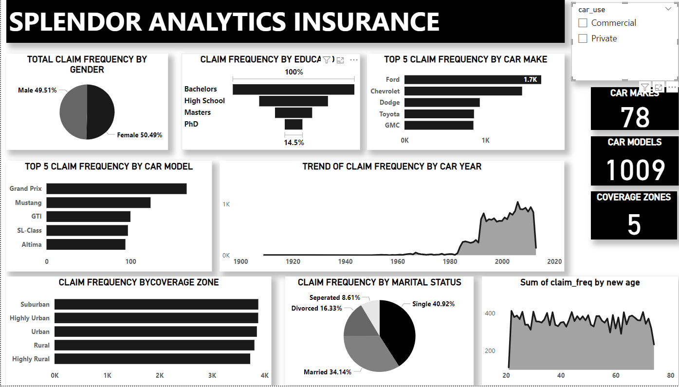
CLAIM FREQUENCY WITHOUT FILTERS

Slide 3
CLAIM FREQUENCY WITHOUT FILTERS
Without filters, we noticed the following:
Gender - Female scored a percentage total of 50.49% and Female scored a percentage total of 49.51% on the Claim Frequency Pie Chart
Education - Bachelors have the highest claim frequency, followed by High School, then Masters. PhD has the lowest Claim Frequency
Car Makes - We looked into a chart of the top 5 Car Make in respect to Claim Frequency. Chevrolet leads, followed by Ford, Dodge and Toyota. GMC holds the 5th position
Car Model - Also looked into a chart of the top 5 Car Models in respect to Claim Frequency, Grand Prix leads, followed by Mustang, GTI and SL-Class. Altima holds the 5th position
Car Year - Cars made in 2006 scored the highest in the trendline chart against Claim Frequency

Slide 4
CLAIM FREQUENCY WITHOUT FILTERS
Coverage Zone - Cars from suburban areas have the most Claim Frequency; Highly Urban, Urban, Rural, Highly Rural came 2nd, 3rd, 4th and 5th respectively
Marital Status - Single Policy Holders have the most Claim Frequency, then Married, Divorced and Separated respectively
Age - Policy Holders with age 22 claimed the most

Slide 5
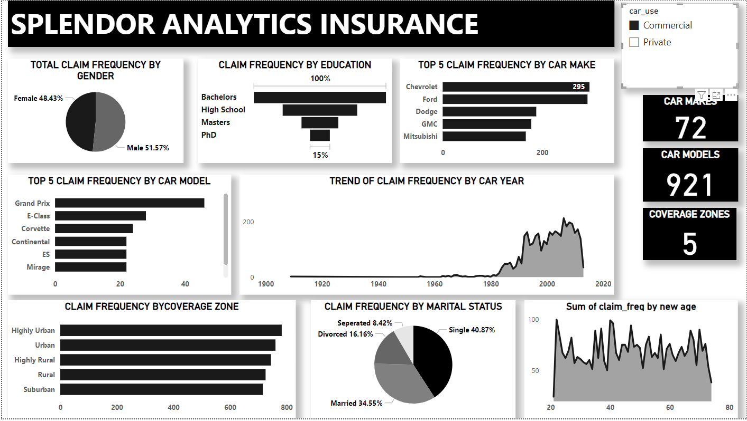
CLAIM FREQUENCY WITH FILTERS - COMMERCIAL VEHICLE USERS

Slide 6
CLAIM FREQUENCY WITH FILTERS - COMMERCIAL VEHICLE USERS
With Commercial vehicle users filter, we noticed the following;
Gender - Male scored a percentage total of 51.57% and Female scored a percentage total of 48.43% on the Claim Frequency Pie Chart
Education - Bachelors have the highest claim frequency, followed by High School, then Masters. PhD has the lowest Claim Frequency
Car Makes - We looked into a chart of the top 5 Car MakeS in respect to Claim Frequency. Chevrolet leads, followed by Ford, Dodge and GMC. Mitsubishi holds the 5th position
Car Model - Also looked into a chart of the top 5 Car Models in respect to Claim Frequency, Grand Prix leads, followed by E-Class, Corvette, Continental and ES. Mirage holds the 5th position
Car Year - Cars made in 2006 scored the highest in the trendline chart against Claim Frequency

Slide 7
CLAIM FREQUENCY WITH FILTERS - COMMERCIAL VEHICLE USERS
Coverage Zone - Cars from suburban areas have the most Claim Frequency; Highly Urban, Urban, Rural, Highly Rural came 2nd, 3rd, 4th and 5th respectively
Marital Status - Single Policy Holders have the most Claim Frequency, then Married, Divorced and Separated respectively
Age - Policy Holders with age 30 claimed the most

Slide 8
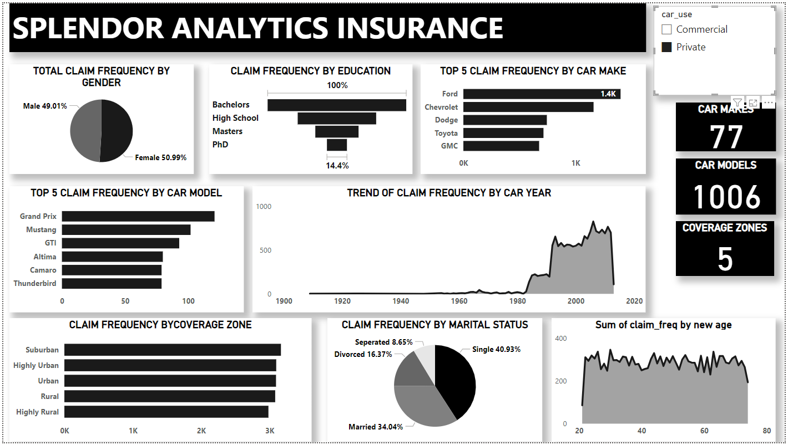
CLAIM FREQUENCY WITH FILTERS - PRIVATE VEHICLE USERS

Slide 9
CLAIM FREQUENCY WITH FILTERS - PRIVATE VEHICLE USERS
With Commercial vehicle users filter, we noticed the following;
Gender - Male scored a percentage total of 49.01% and Female scored a percentage total of 50.99% on the Claim Frequency Pie Chart
Education - Bachelors have the highest claim frequency, followed by High School, then Masters. PhD has the lowest Claim Frequency
Car Makes - We looked into a chart of the top 5 Car MakeS in respect to Claim Frequency. Ford leads, followed by Chevrolet, Dodge and Toyota. GMC holds the 5th position
Car Model - Also looked into a chart of the top 5 Car Models in respect to Claim Frequency, Grand Prix leads, followed by Mustang, GTI and Altima. Camaro/Thunderbird holds the 5th position
Car Year - Cars made in 2006 scored the highest in the trendline chart against Claim Frequency

Slide 10
CLAIM FREQUENCY WITH FILTERS - PRIVATE VEHICLE USERS
Coverage Zone - Cars from suburban areas have the most Claim Frequency; Highly Urban, Urban, Rural, Highly Rural came 2nd, 3rd, 4th and 5th respectively
Marital Status - Single Policy Holders have the most Claim Frequency, then Married, Divorced and Separated respectively
Age - Policy Holders with age 30 claimed the most

Slide 11
RISK ASSESSMENT
Gender - Without filters, females made the most claim. Commercial, male cars made the most claim. Private, female cars made the most claim as well. But it should be noted that the difference are close to being insignificant. Therefore, it cannot be said to be a major determinant of high risk policy holders
Education - Car users with Bachelors degree have the most claim in all (with & without filters). PhD holders have the least claim in all (with & without filters)
Marital Status - Single Car users have the highest claim while separated has the lowest claim in all three categories
Common characteristics among high risk policy holders - They are Single and also Bachelors degree holders

Slide 12
DEMOGRAPHIC ANALYSIS
Age - Policy holders at age 22 are high risk Commercial users, age 30 are also high risk Private users
Gender - This is evenly distributed with insignificant differences on all filters
Marital Status - Single people are high risk policy holders and Separated people are very low risk policy holders

Slide 13
GEOGRAPHICAL ANALYSIS
Without filters; policy holders staying in Suburban zones are the highest risks as they make the most claim. Highly rural makes the least.
With the Commercial filter; policy holders in Highly Urban zones are the highest risks and make the most claim while Suburban zones make the least claim
With the Private filter; policy holders in Suburban zones are the highest risks and make the most claim while Highly Rural zones make the least claim

